Slide 1
Optical Illusions Version 2
Your goal:
Choose just one of the optical illusions on the following slides and draw it in a processing PApplet. Your drawing must look just like the sample – including color and line width.
Limitations:
You can only have 2 classes – one with a main method, and a drawing surface extending PApplet.
Your drawing surface cannot call any PApplet methods, period – only create shape objects and draw them.
Your shapes library can’t do what you need it to do? Update it!

Slide 2
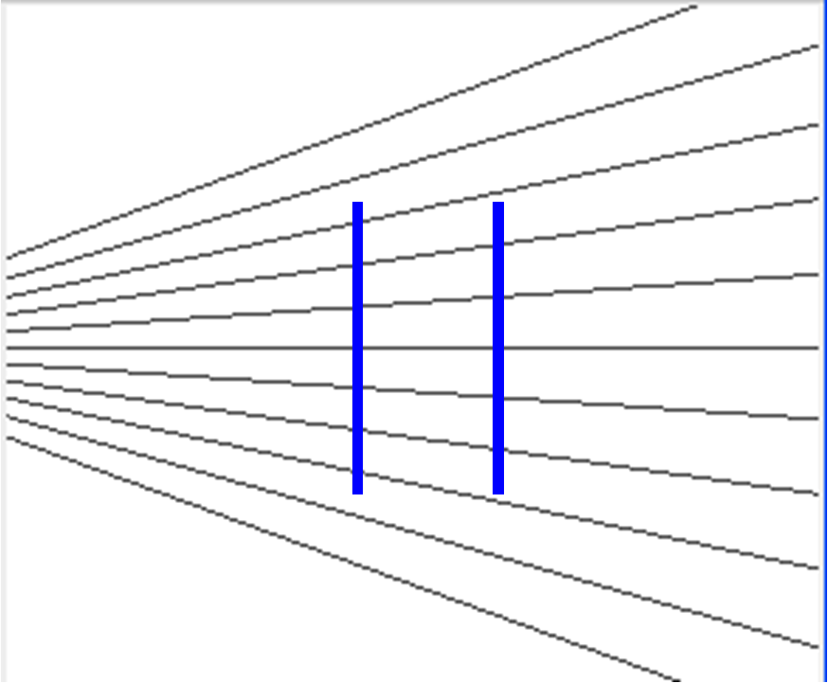

Slide 3
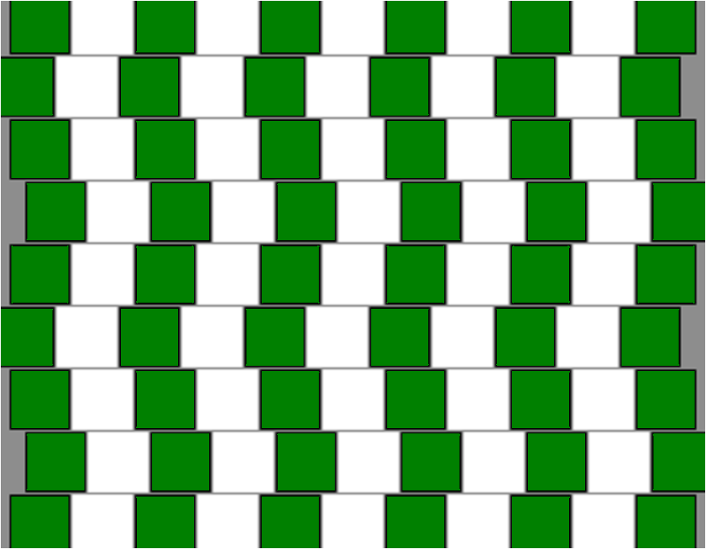

Slide 4
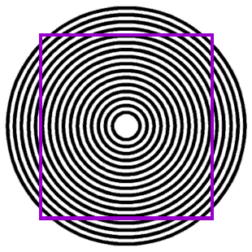

Slide 5
